Slide 1
Big Data Architecture and Governance
Group Assignment | Team 8 Dallas Police Incidents
Jin Ding - 002684907 Lavina Pinto - 001564503 Snehal Kisan Padekar - 002737903

Slide 2
Dataset Case - Dallas Police Incidents
This dataset represents the Dallas Police Public Data - RMS Incidents beginning June 1, 2014 to current-date, and it reflects crimes as reported to the Dallas Police Department as of the current date.
The Dallas Police Department strives to collect and disseminate police report information in a timely, accurate manner.
This dataset can make it easier for citizens to access offense reports. To ensure that privacy concerns are protected and legal standards are met, report data is "filtered" prior to being made available to the public.

Slide 3
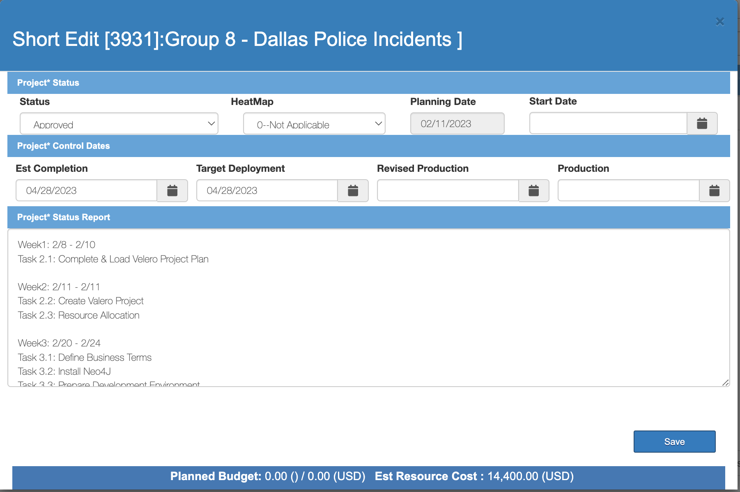
Velero Activities - Project (Short Form)

Slide 4
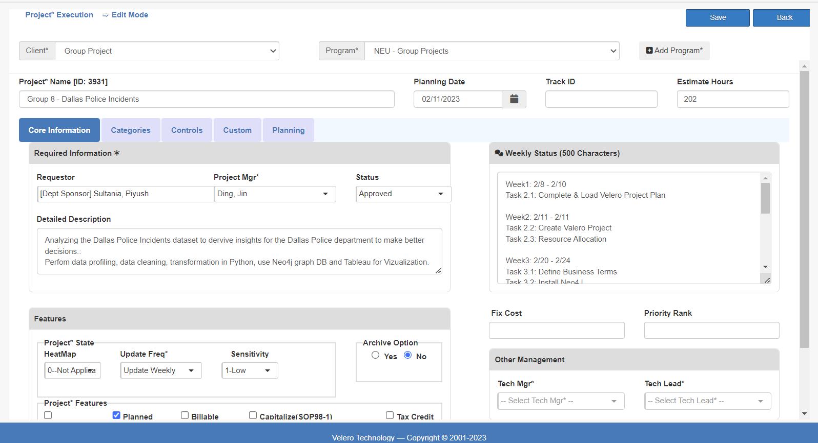
Velero Activities - Project (Long Form)

Slide 5
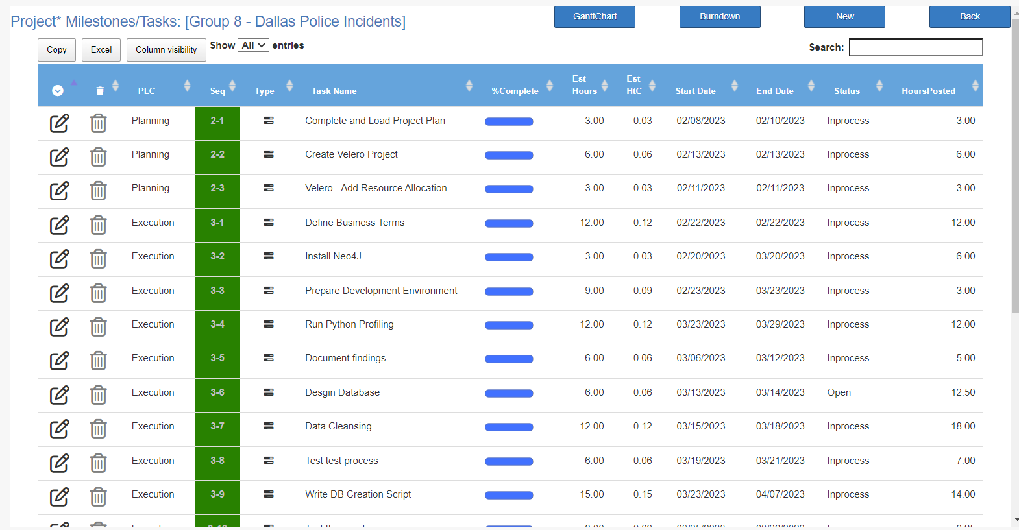
Velero Activities - Tasks (Project Plan)

Slide 6
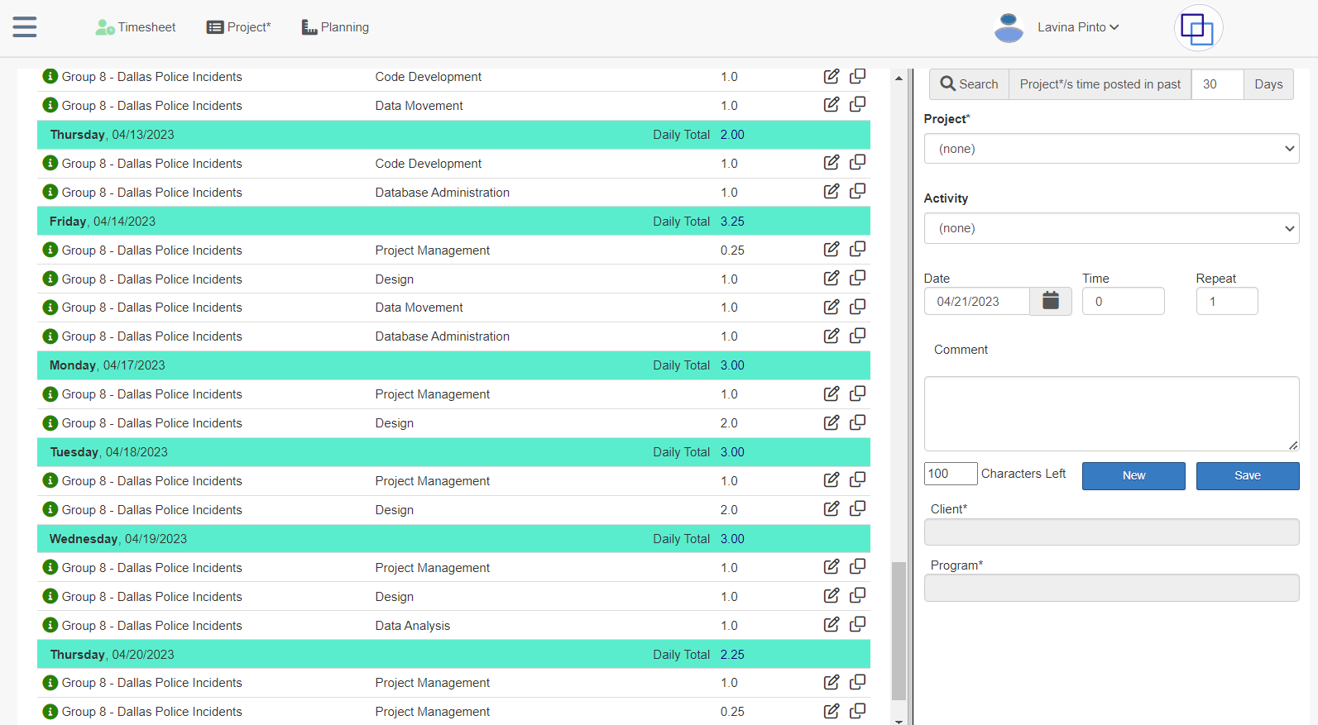
Velero Activities - Timesheet

Slide 7
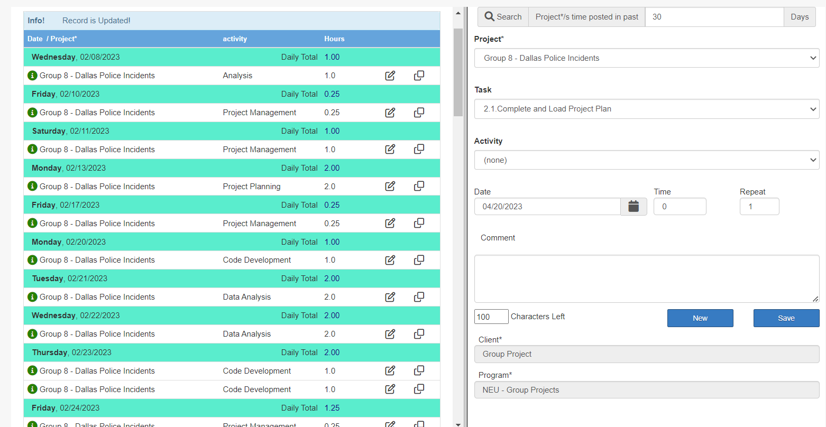
Velero Activities - Timesheet

Slide 8
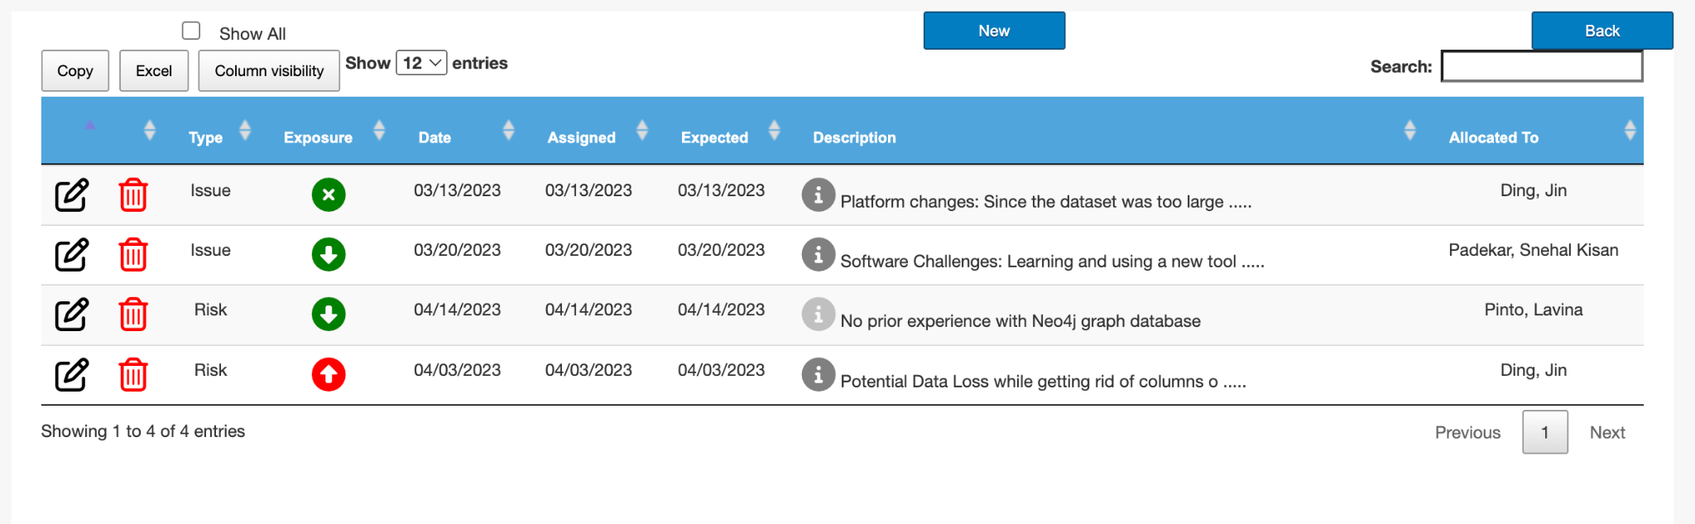
Velero Activities - Risk/Issues

Slide 9
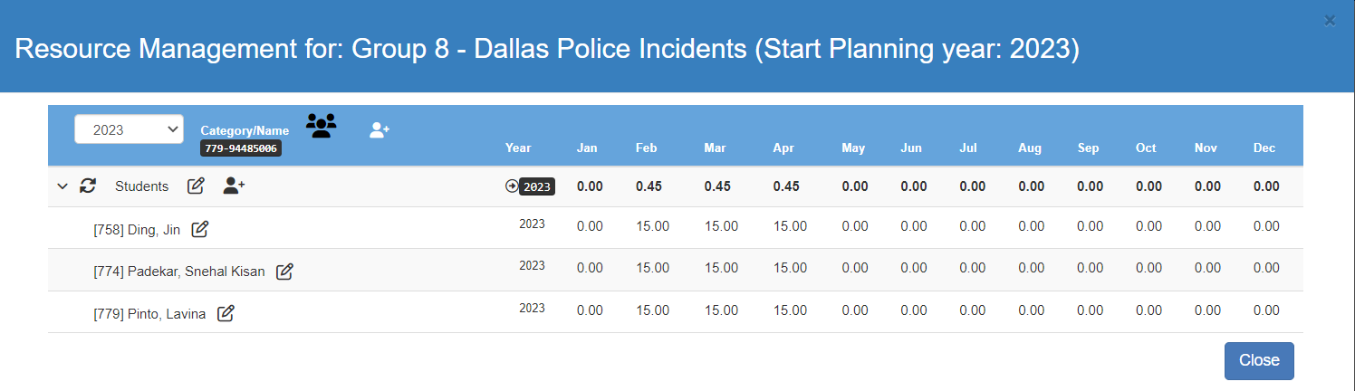
Velero Activities - Group Allocation

Slide 10
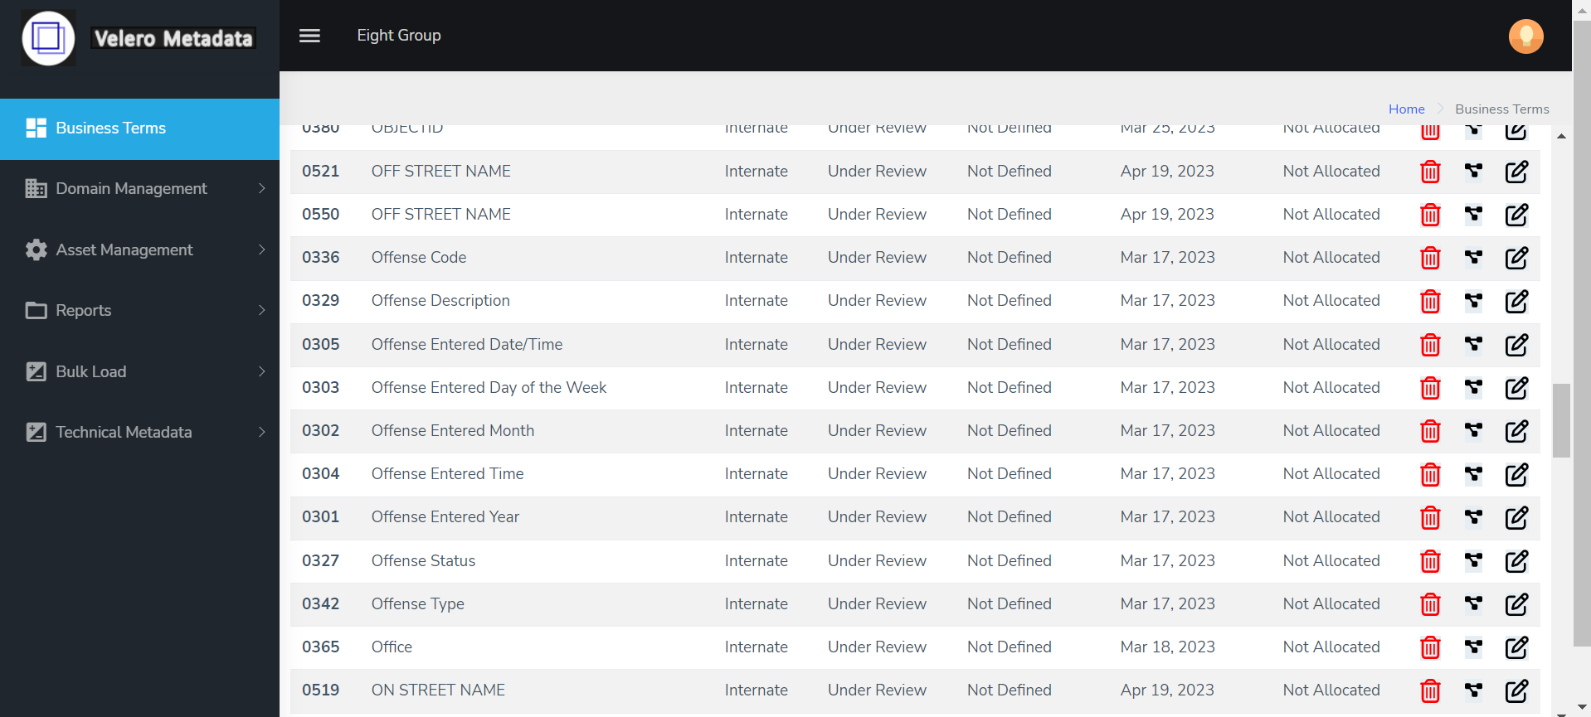
Business Terms

Slide 11
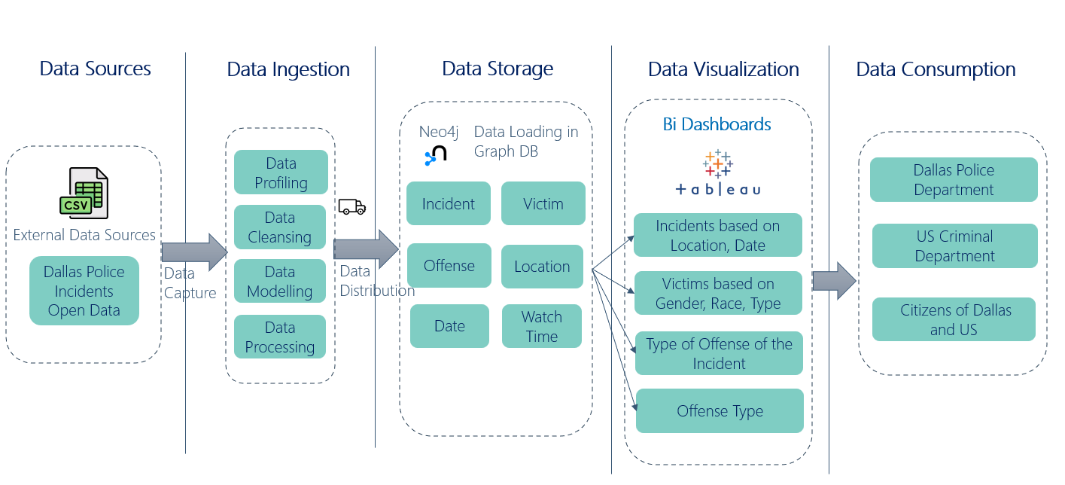
Documentation - Vision Diagram

Slide 12
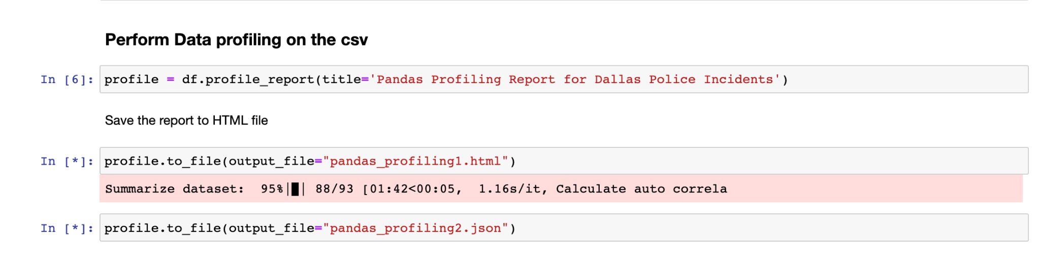
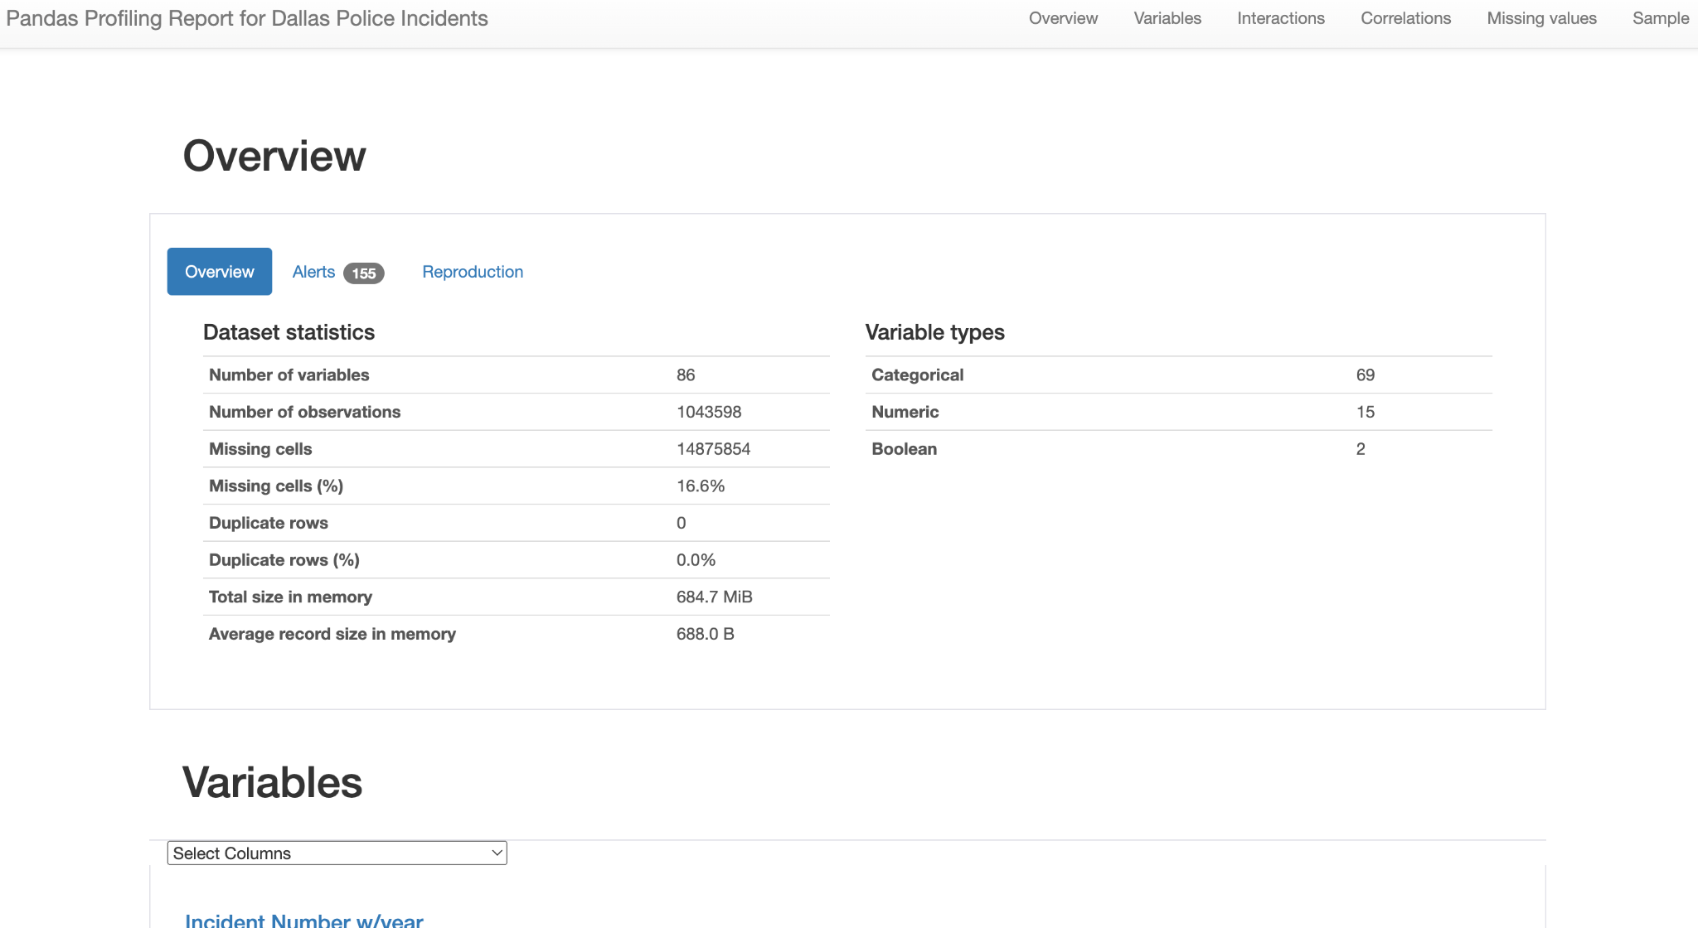
Data Profiling
Using pydata-profiling library

Slide 13
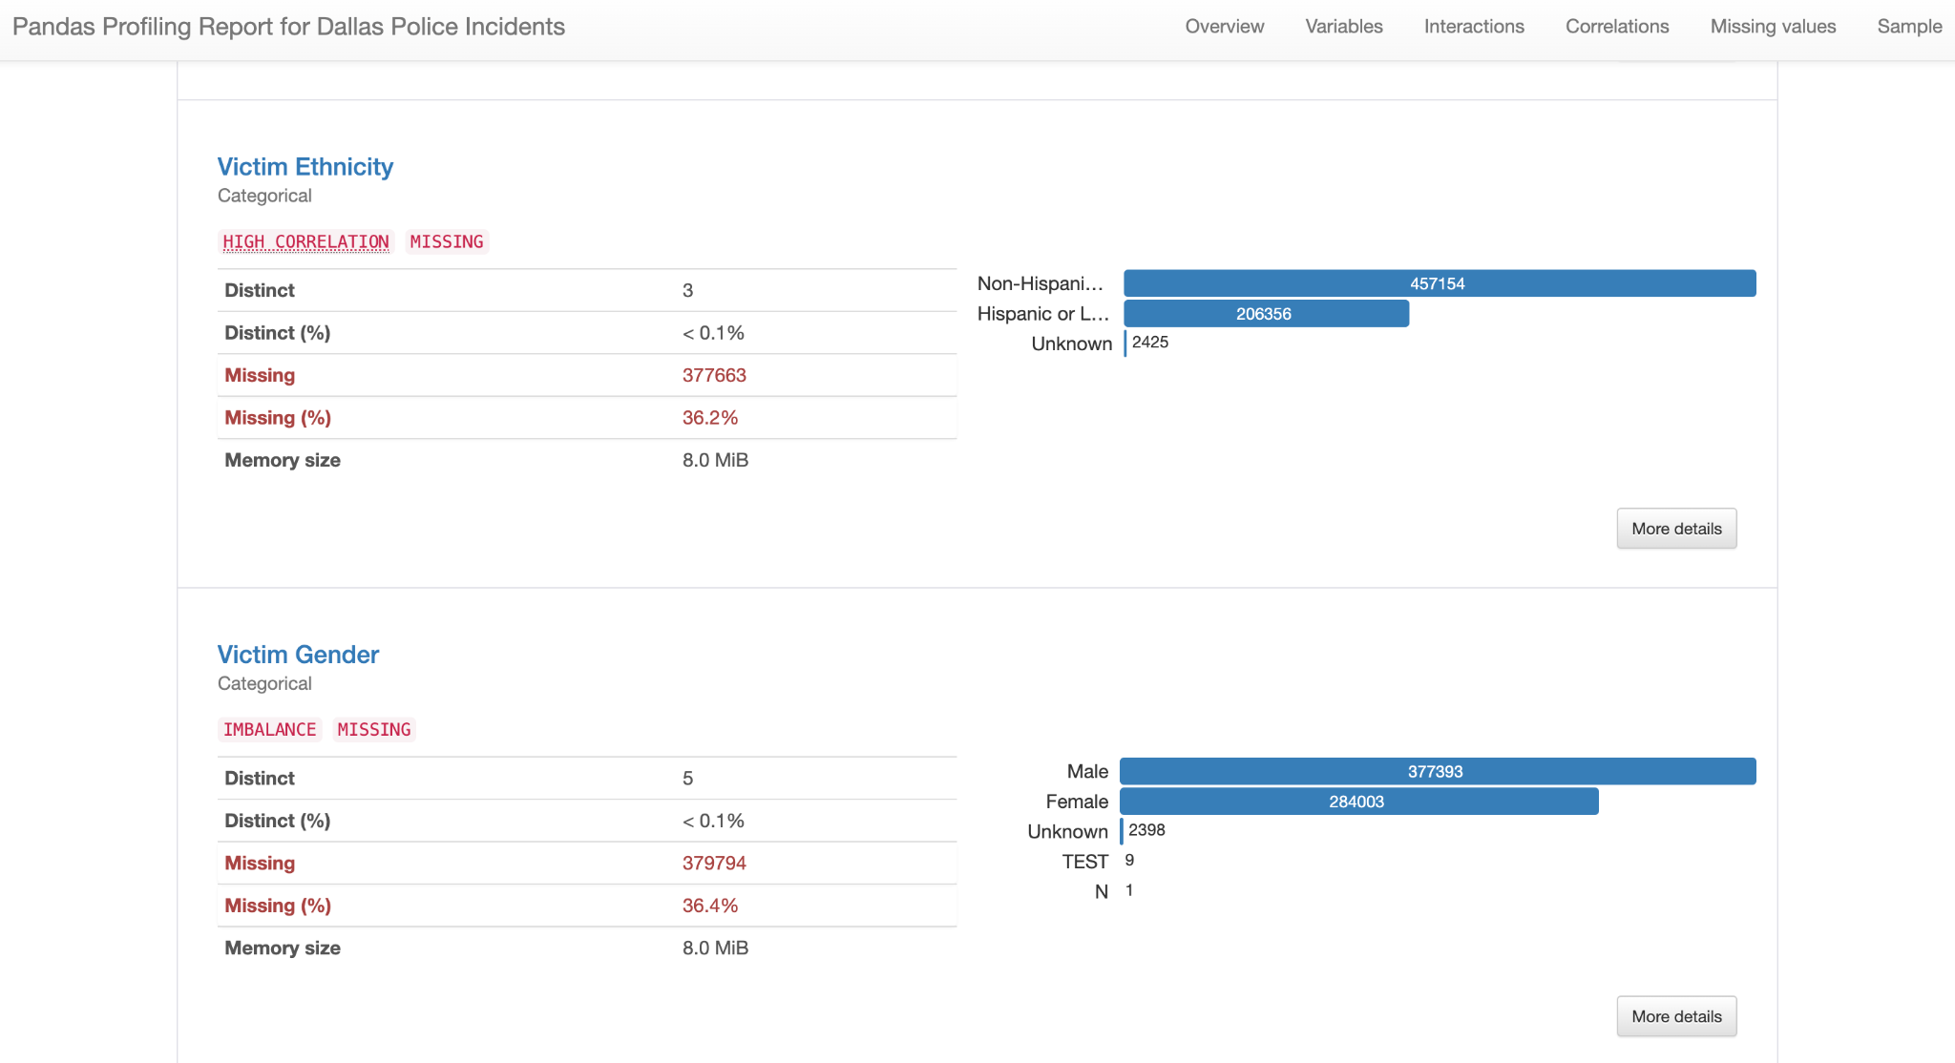
Data Profiling
Using pydata-profiling library

Slide 14
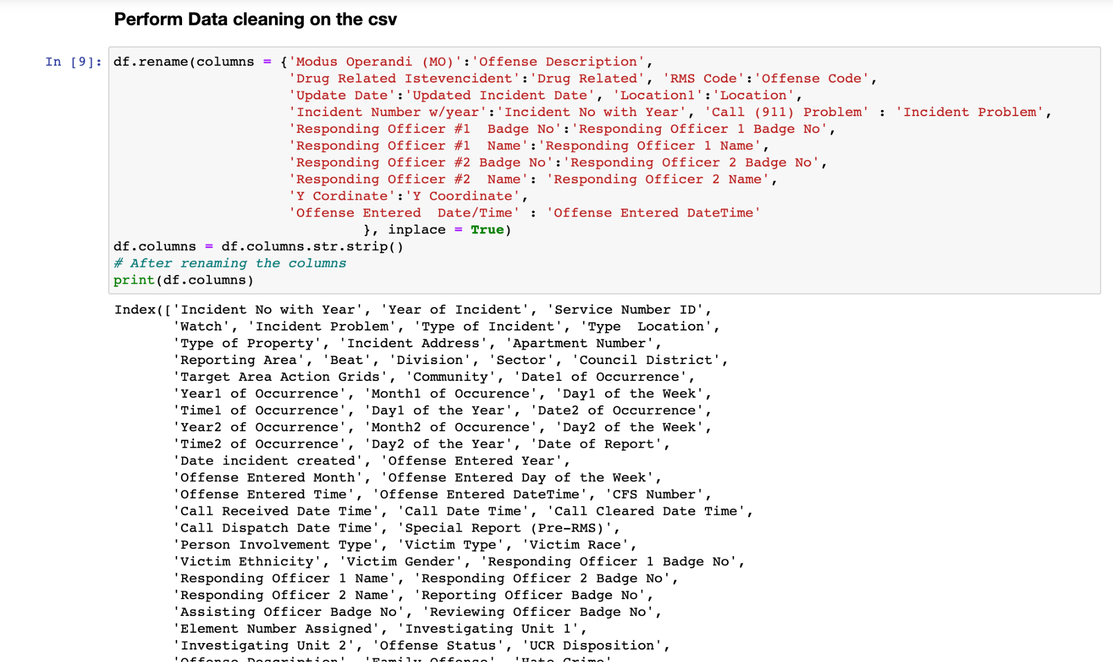
Data Wrangling and Cleansing
Renamed columns according to the business terms. We defined business terms for the columns and renamed the columns to an appropriate column name in python.

Slide 15
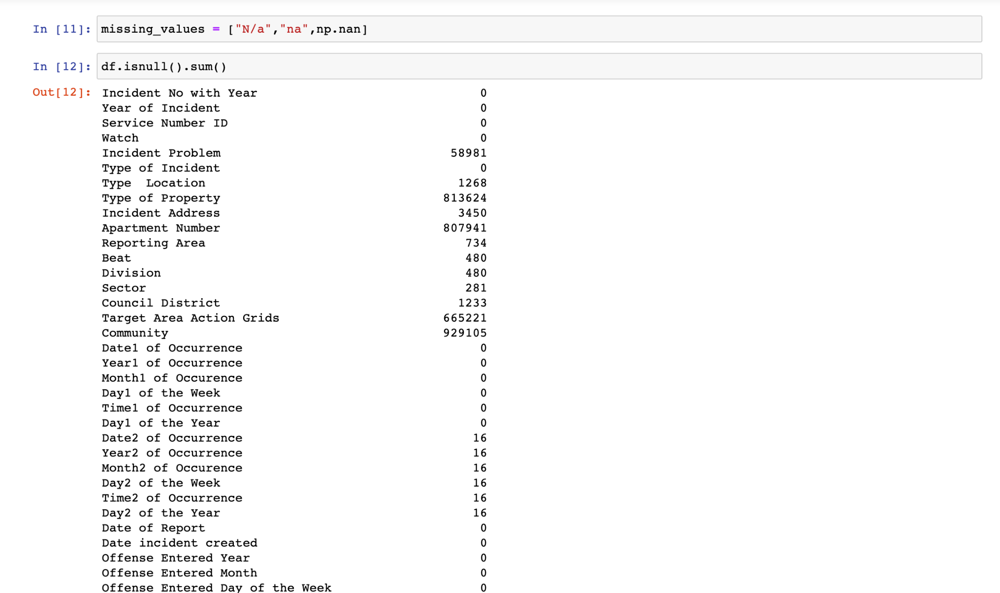
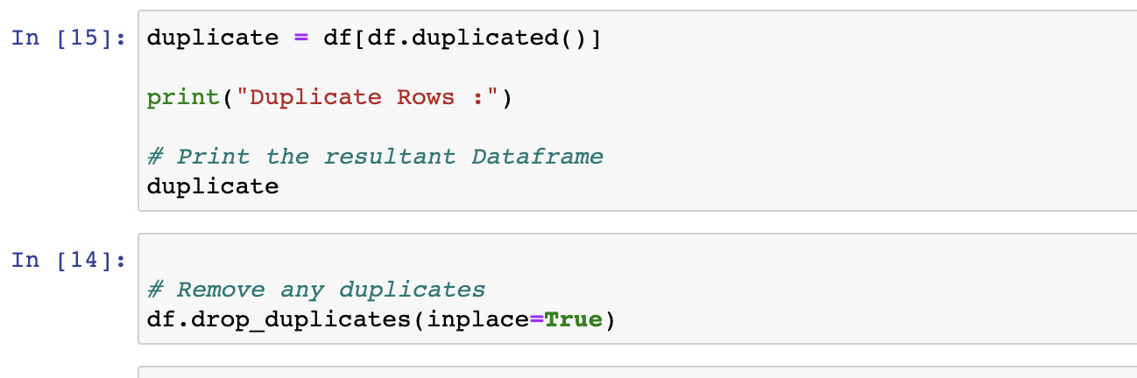
Data Wrangling and Cleansing
Checked null values
Dropped duplicates

Slide 16
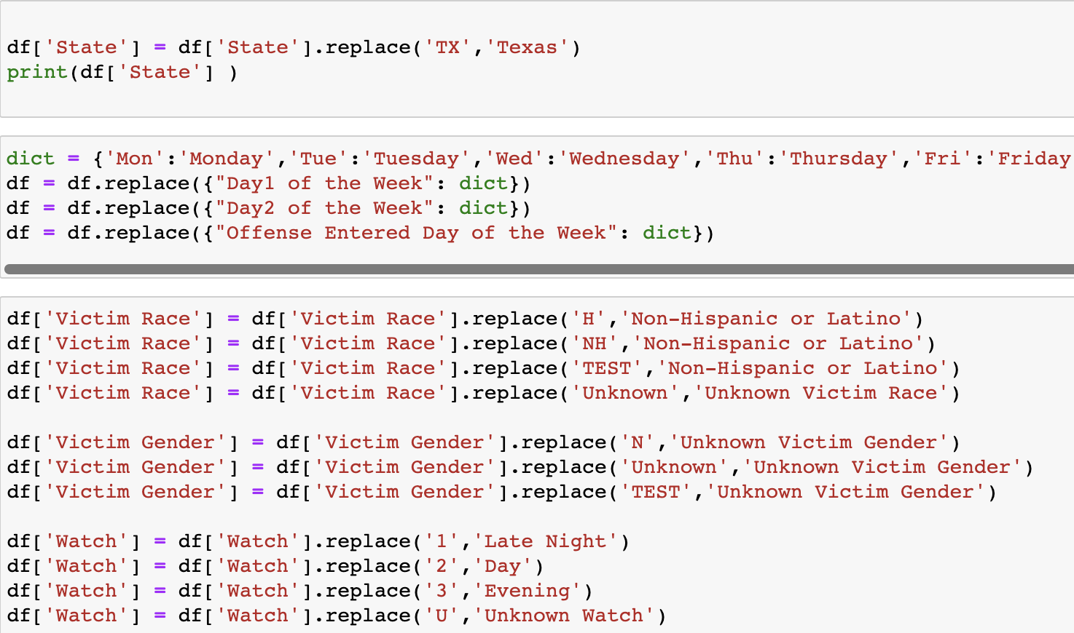
Data Wrangling and Cleansing
Renamed the column state
to its full name
Renamed the day of the week
to its full name

Slide 17
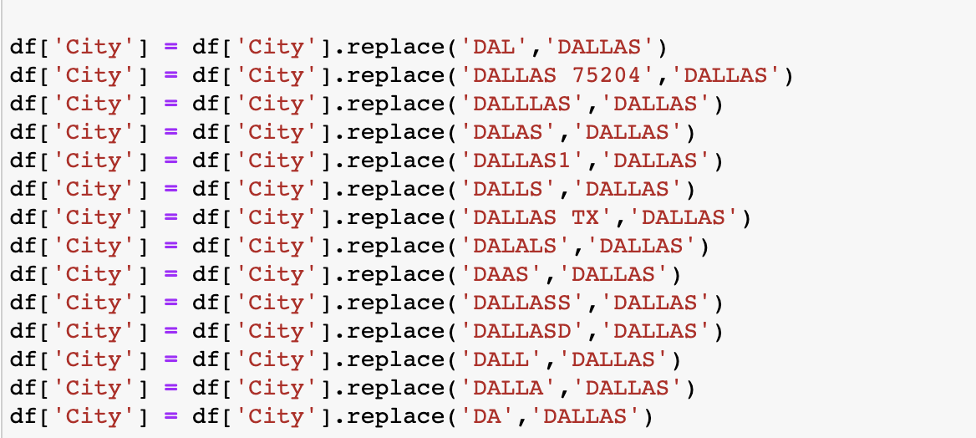
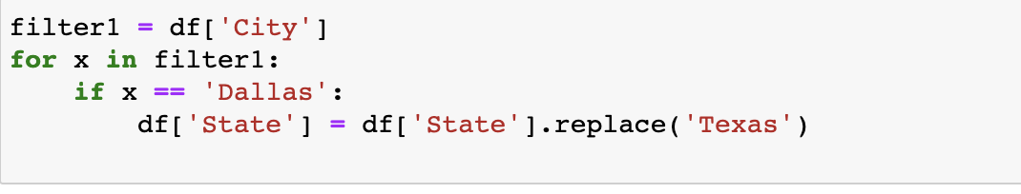
Data Wrangling and Cleansing
The column City had many uncleaned data for the city name like DAAL, DALALS, DALAS So we renamed them all to Dallas.
We renamed the State as Texas wherever the city is Dallas.

Slide 18
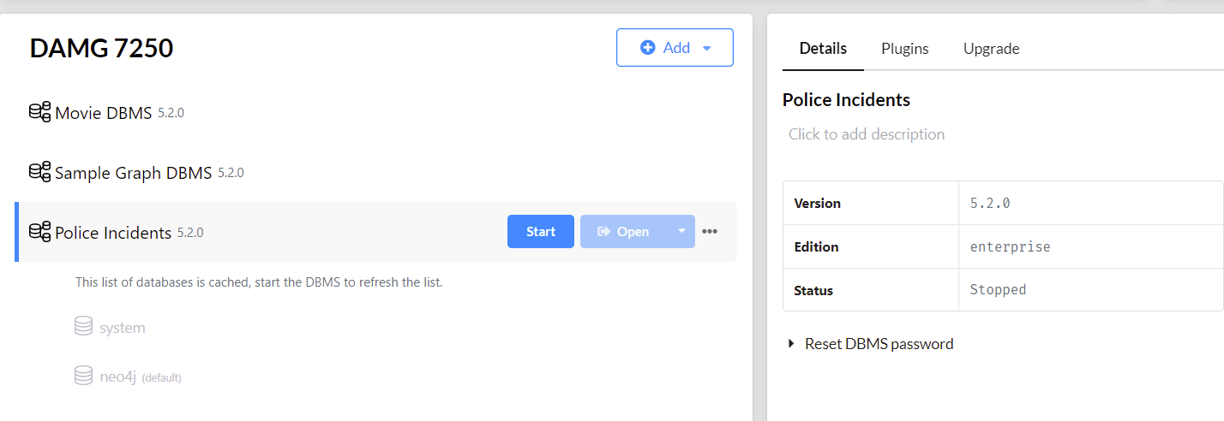
Database Installation
Installed Neo4j Database

Slide 19
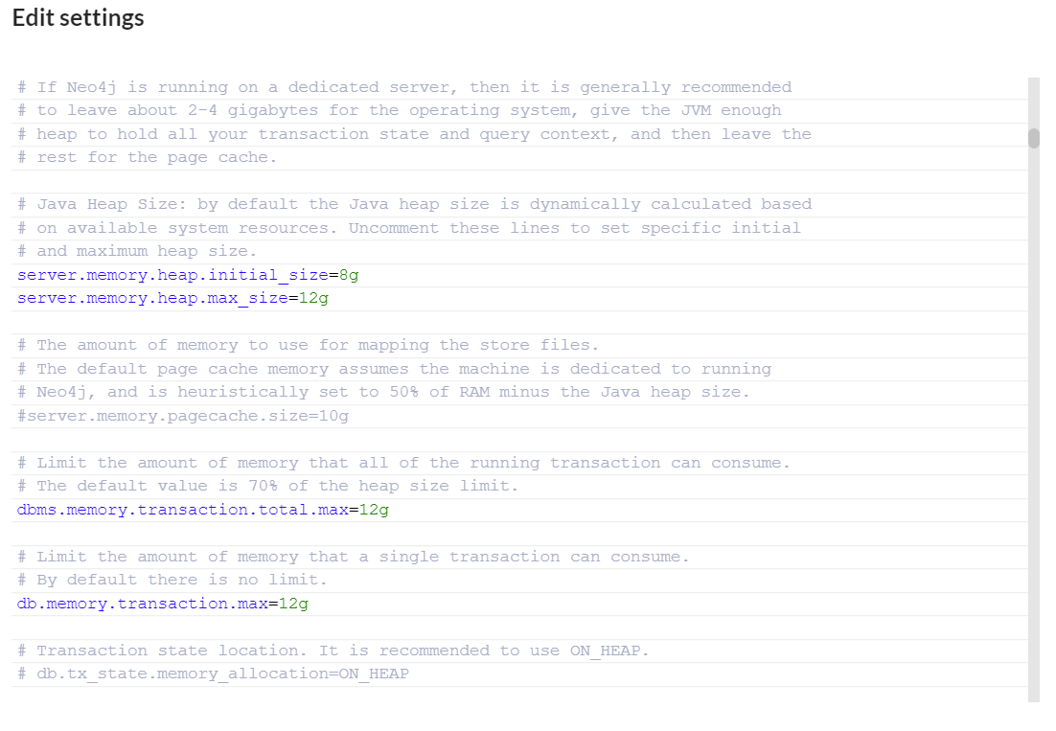
Database Installation
Changed memory settings for faster loading and processing of data.

Slide 20
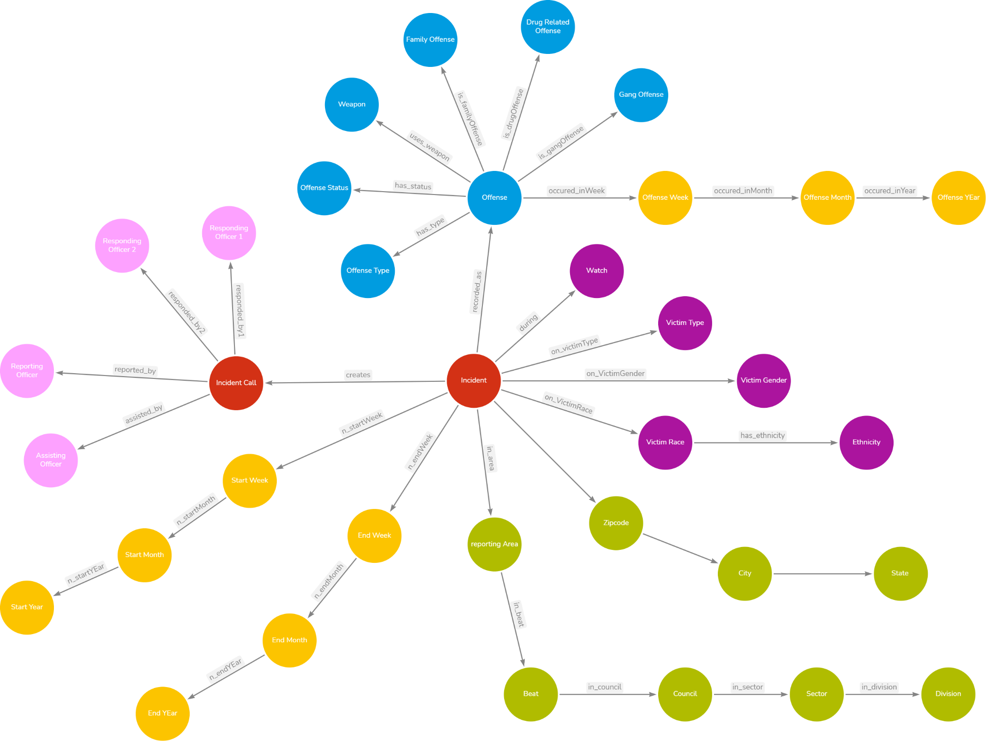
Graph Data Modeling

Slide 21
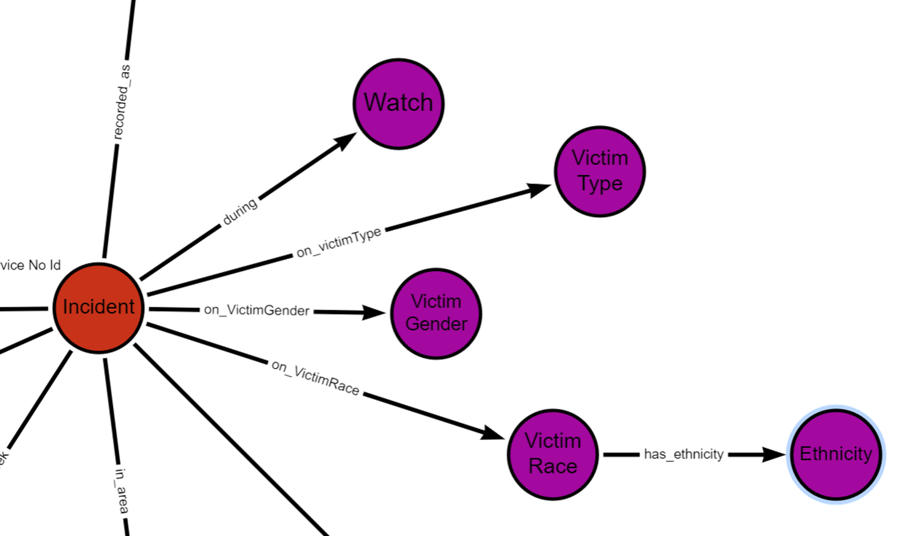
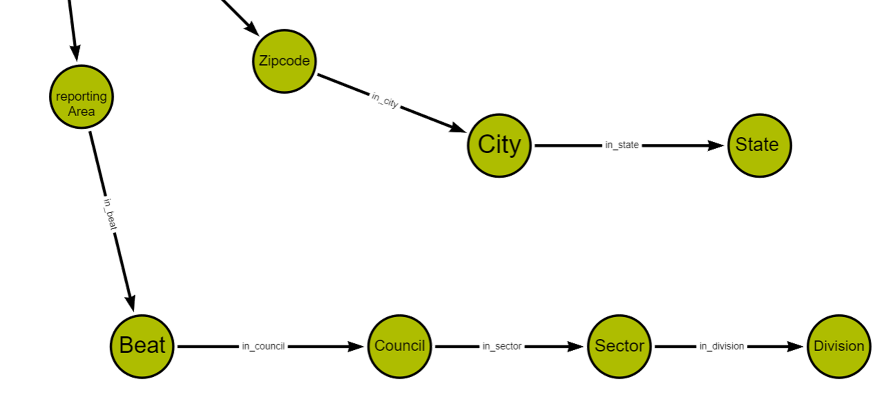
Graph Data Modeling

Slide 22
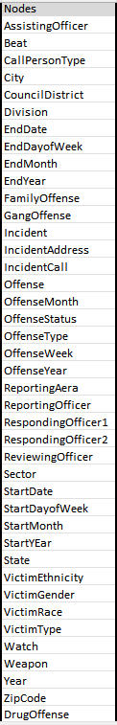
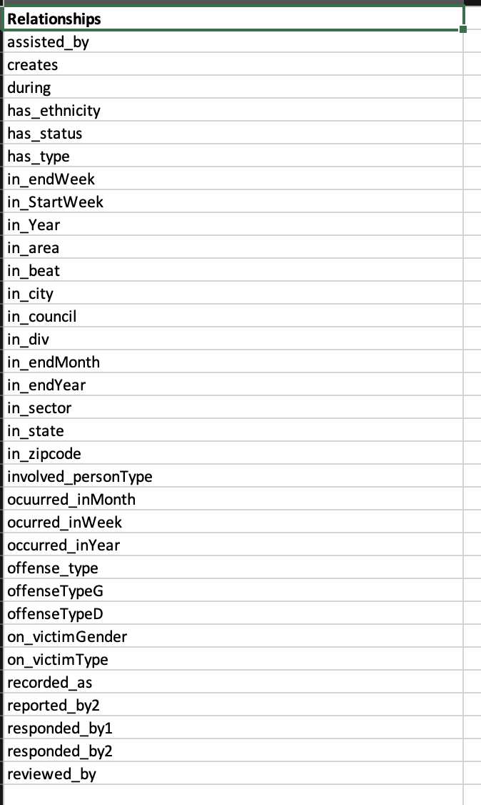
Data Mapping and Integration

Slide 23
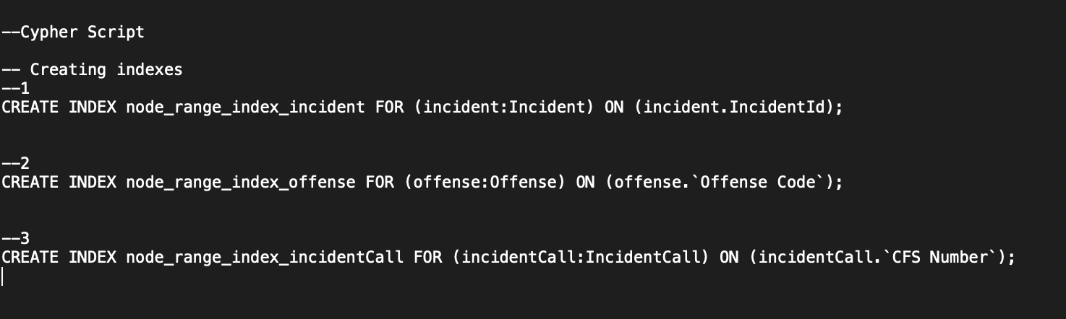
Cypher Scripts - Indexes

Slide 24
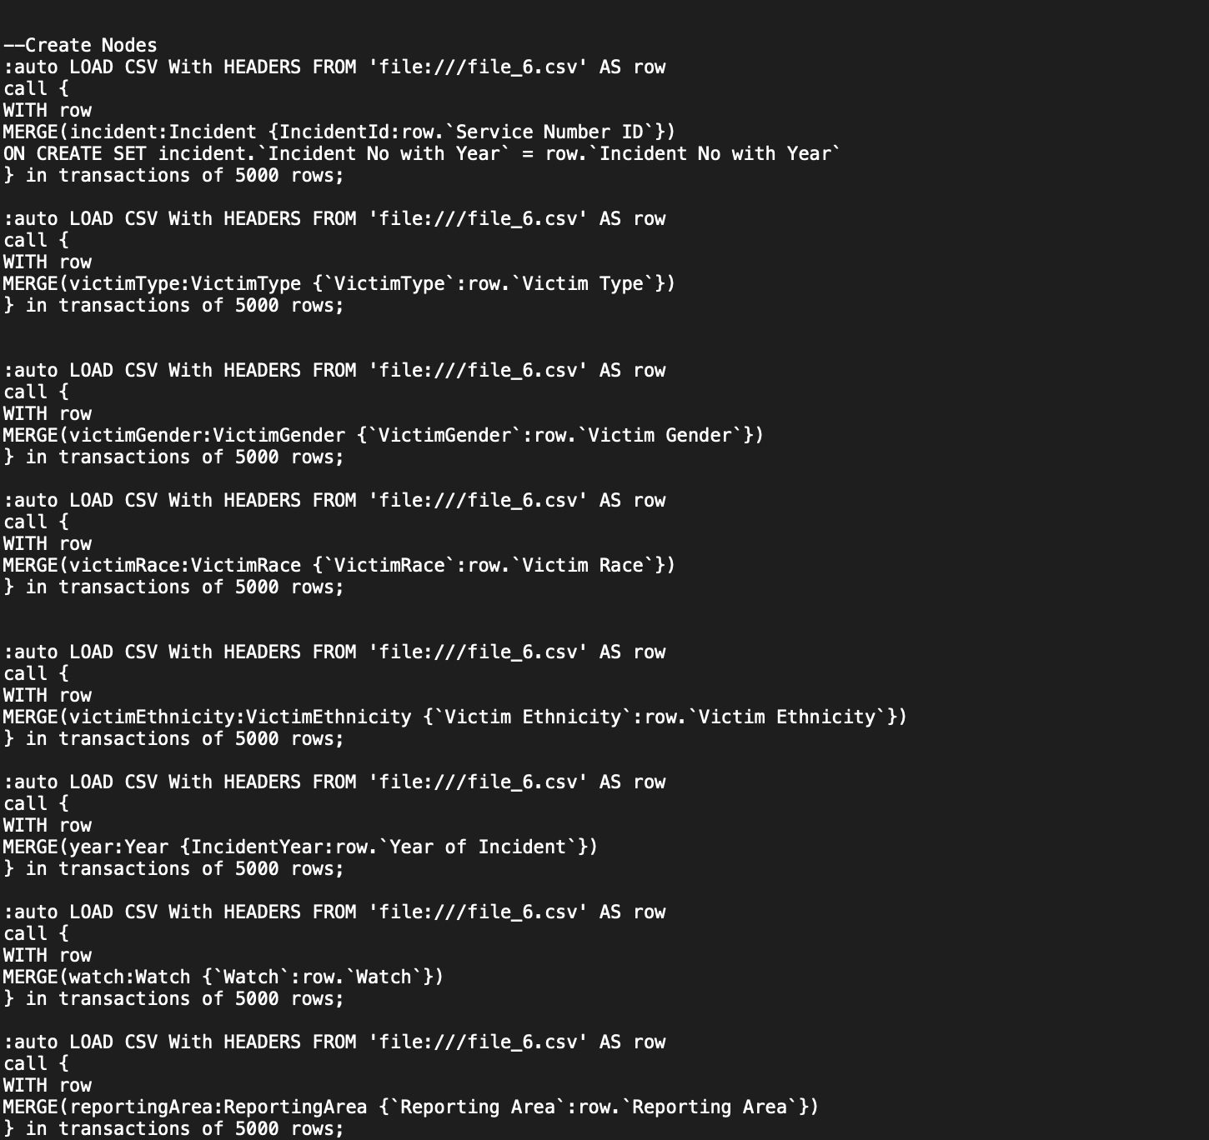
Cypher Scripts - Nodes

Slide 25
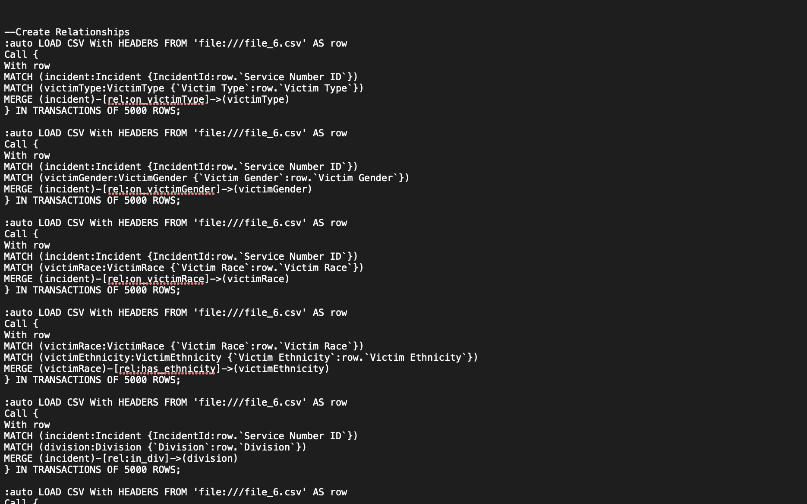
Cypher Scripts - Relationships

Slide 26
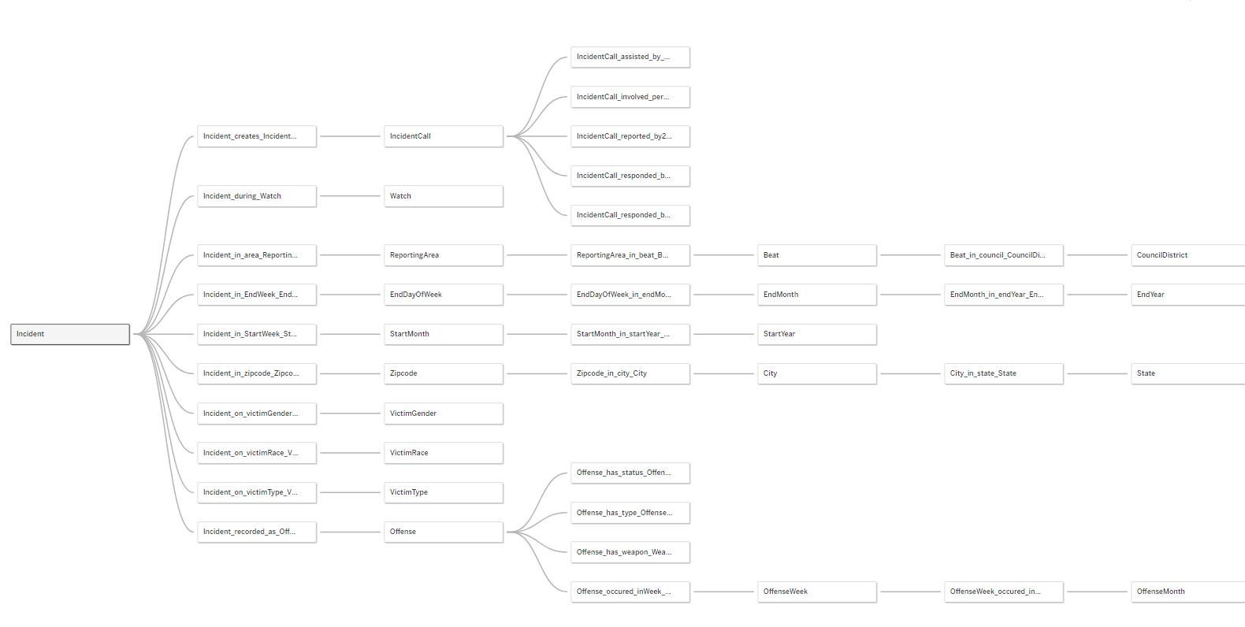
Data Visualization - Data Source

Slide 27
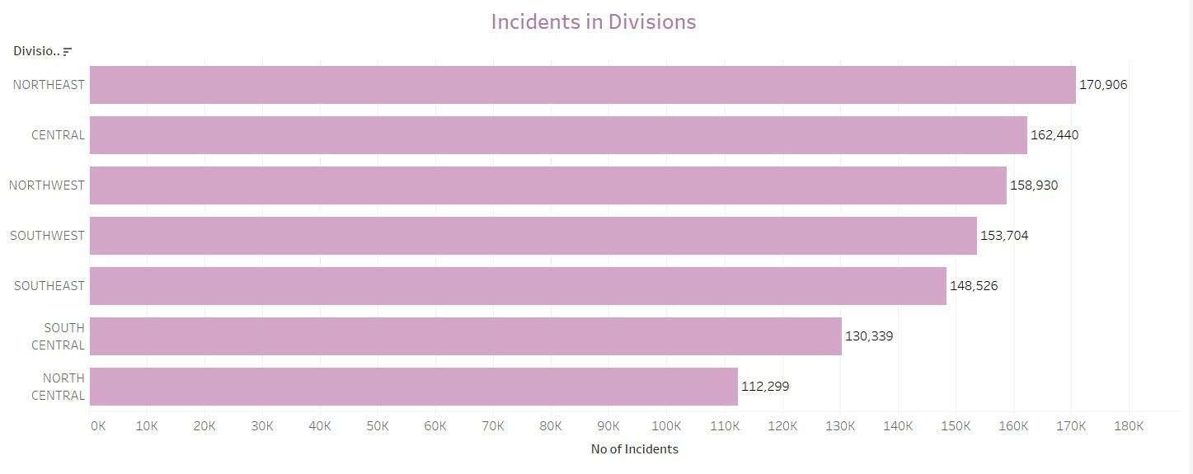
Data Visualization

Slide 28
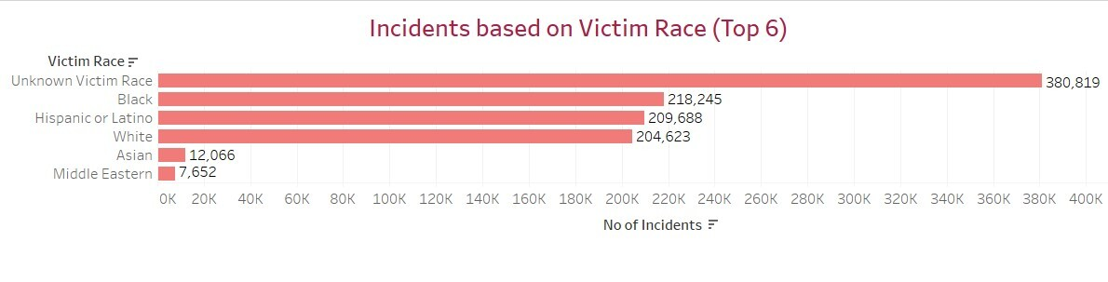
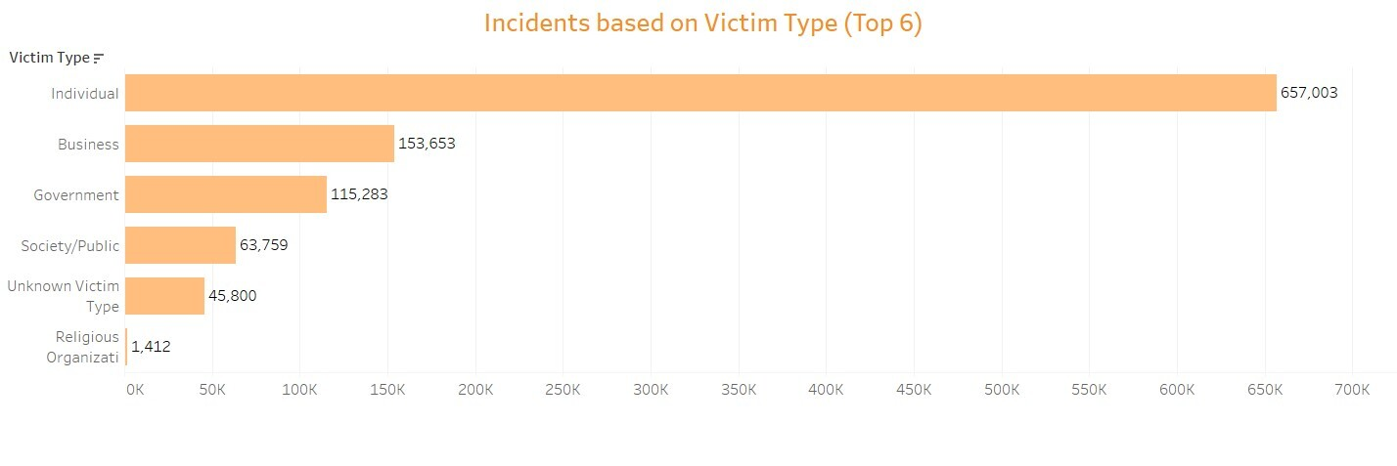
Data Visualization

Slide 29
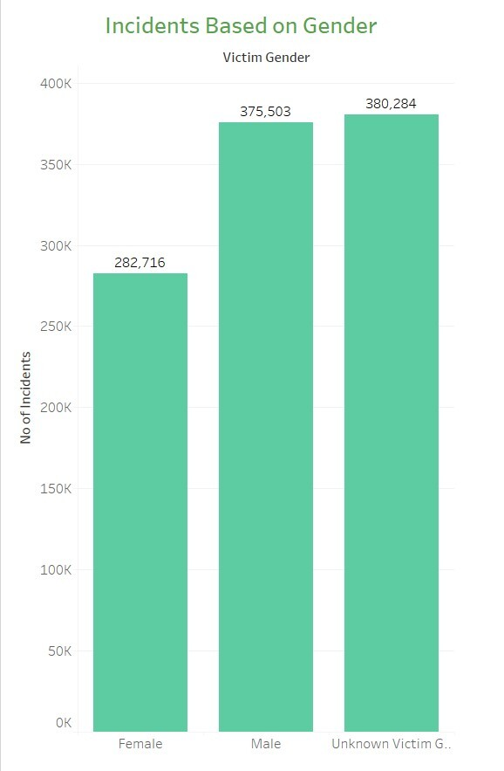
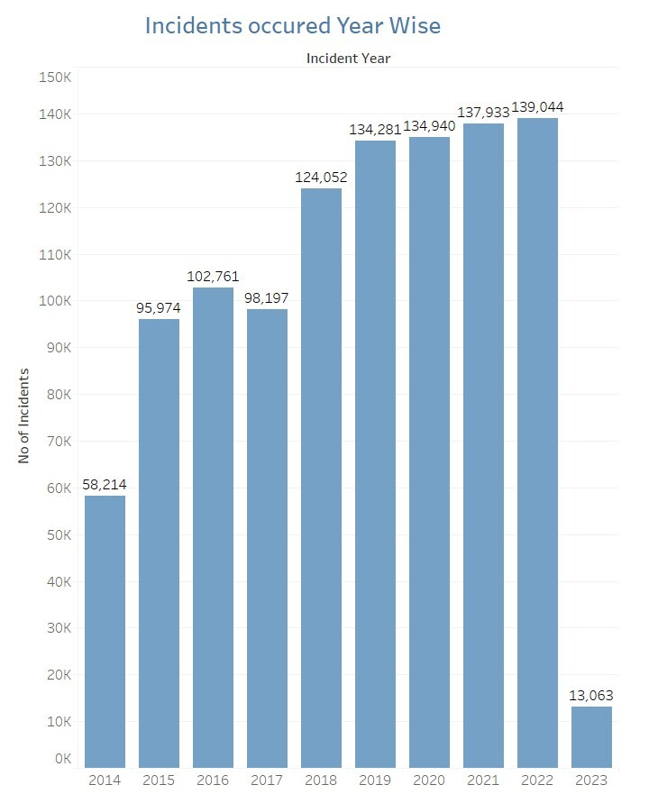
Data Visualization

Slide 30
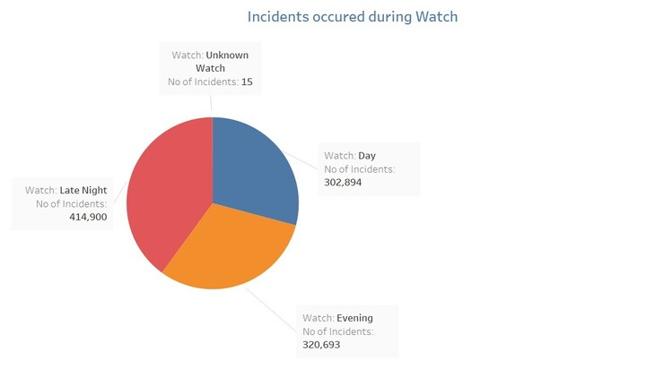
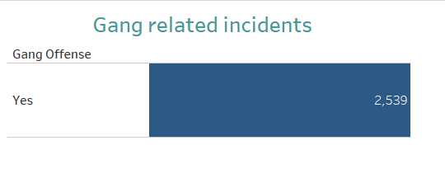
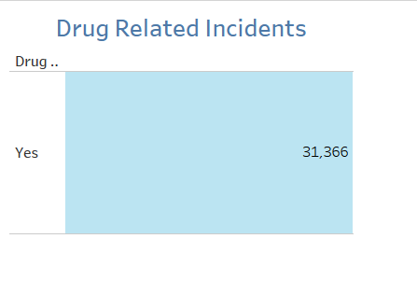
Data Visualization

Slide 31
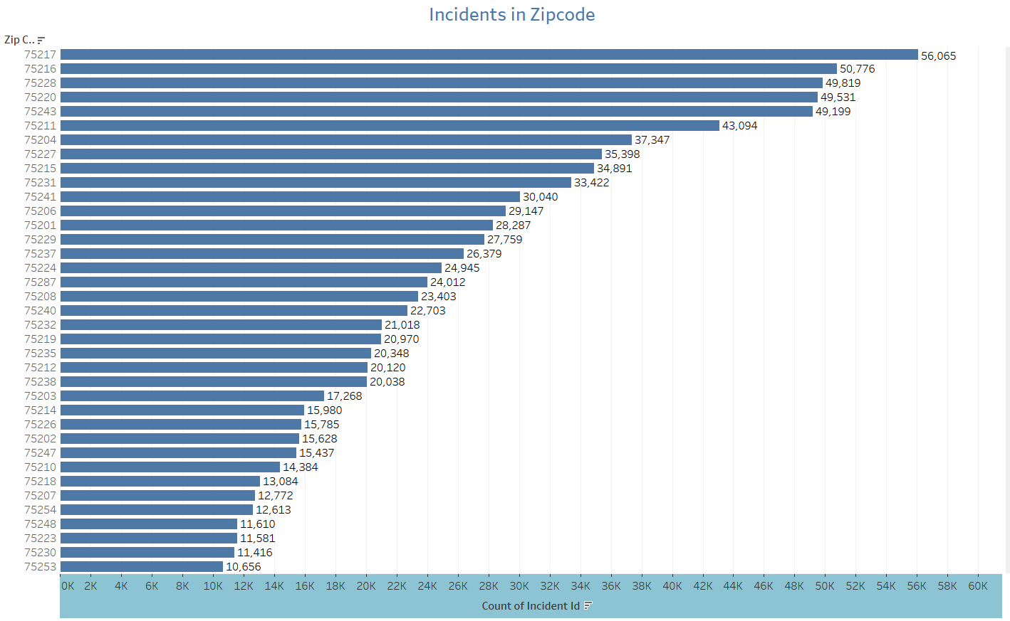

Slide 32
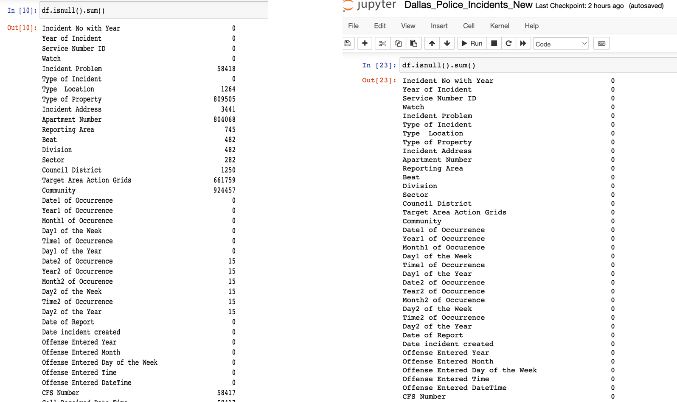
System Integration and User Acceptance Testing
Test Case 1 : Checking for NULL values

Slide 33
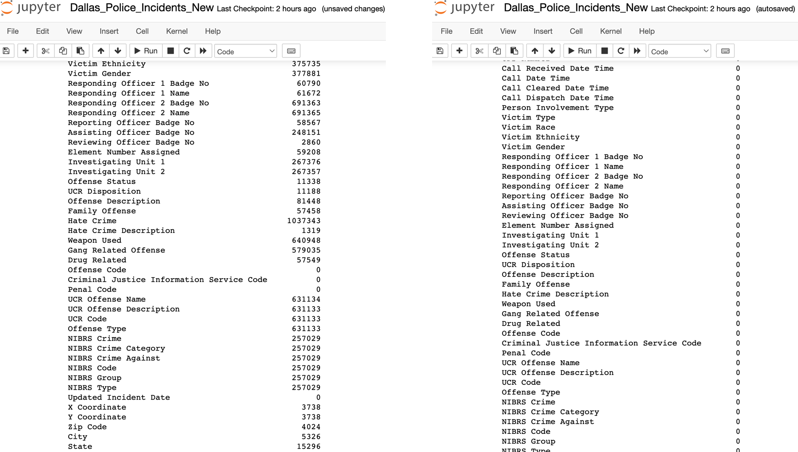
System Integration and User Acceptance Testing
Test Case 1 : Checking for NULL values

Slide 34
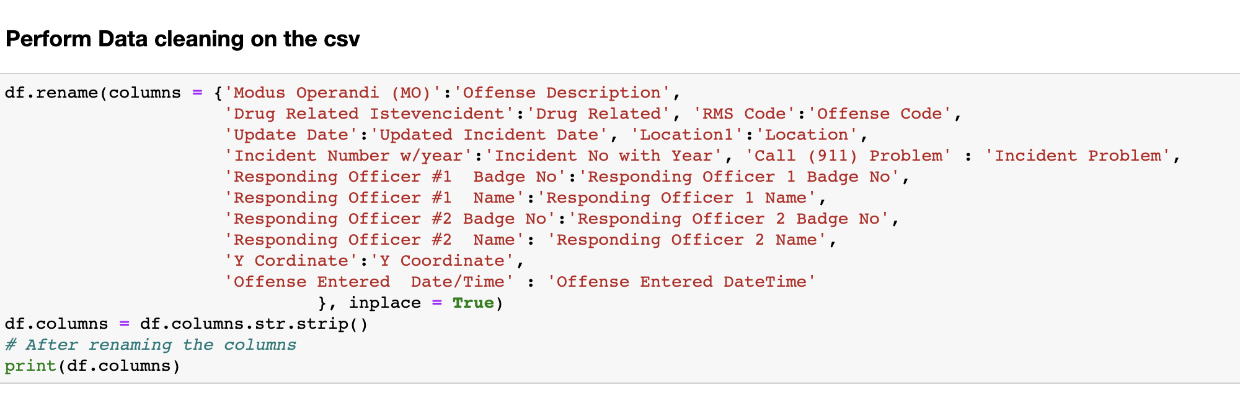
System Integration and User Acceptance Testing
Test Case 2 : Renaming Columns
Test Description: Renamed specific columns for better understanding pertaining to business terms. Ensured that the columns very successfully renamed.

Slide 35
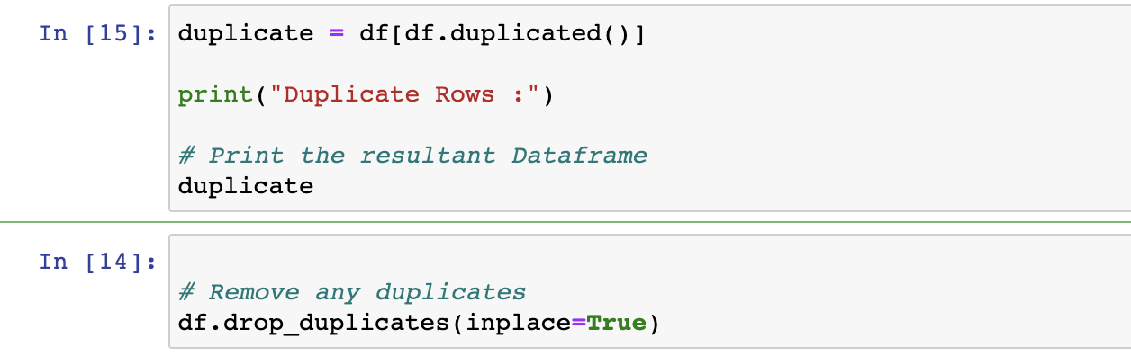
System Integration and User Acceptance Testing
Test Case 3 : Dropping Duplicates

Slide 36
Challenges Encountered
Problem: Limited information on the website for Dallas Police incidents
Solution:
Conducted own research to find meaning to the column names
Renamed column names according to the business terms
Problem: Processing of large dataset with too many columns
Solution:
Using Jupyter-lab for data profiling and cleaning
Splitting the dataset into multiple files for faster loading of data
Creating indexes on nodes for faster loading of data
Problem: Bad data present in the dataset for some columns Eg: The State column had values like TX, T, Texas for Texas
Solution: Performed data cleaning in Python by adding different logic.
Problem: Large number of null values present in the dataset.
Solution: Handled null values for each column type during data cleaning in python

Slide 37
Thank you!
Group Assignment | Team 8 Dallas Police Incidents
Jin Ding - 002684907 Lavina Pinto - 001564503 Snehal Kisan Padekar - 002737903

